Slide 1
Self Join

Slide 2
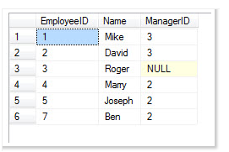
Self Join
A self-join is joining a table to itself.
Write a query to display the employee and their manager details.
Output should like:
Employee Name Manager Name

Slide 3

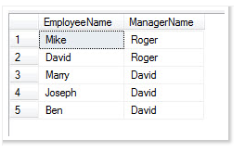

Slide 4
Class Activity
From the result set, we can see that all the employees who have a manager are visible.
However we are unable to find out the top manager of the company as he is not visible in our result set.
The reason for the same is that due to inner join, his name is filtered out. Inner join does not bring any result which does not have manager id.

Slide 5
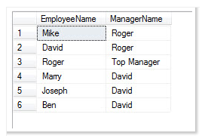
Write a query to display following output.

